Slide 1
BarBeerDrinker
By: Christopher Pasigna, Revanth Vallabhaneni, Samer Shaban

Slide 2
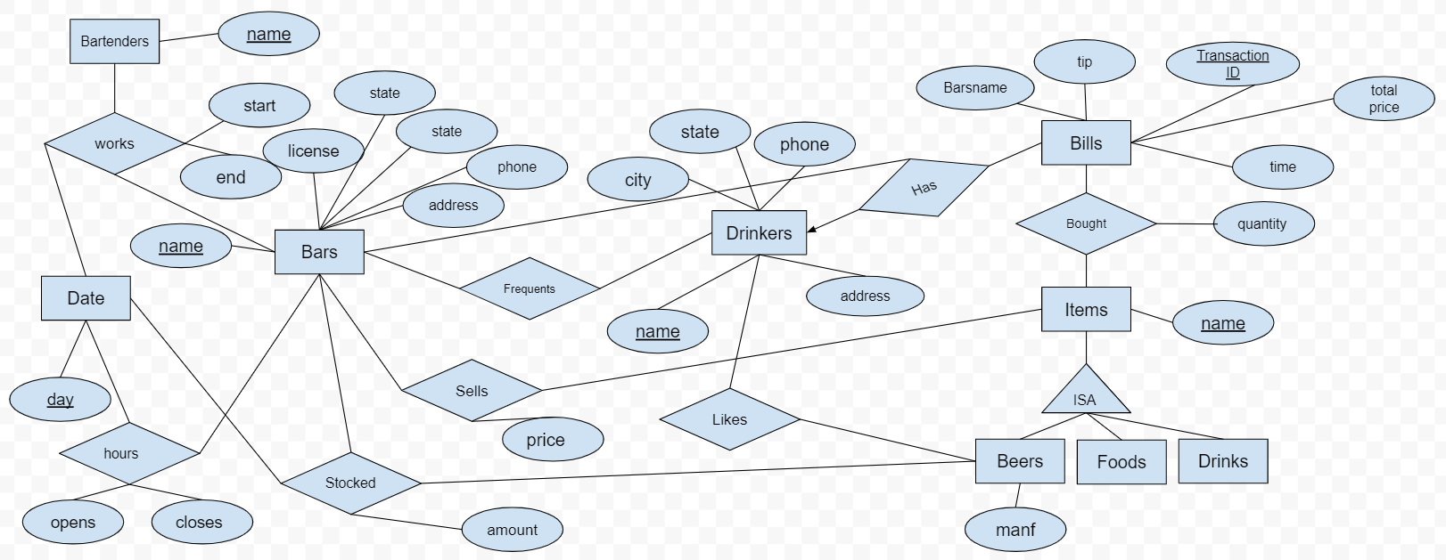
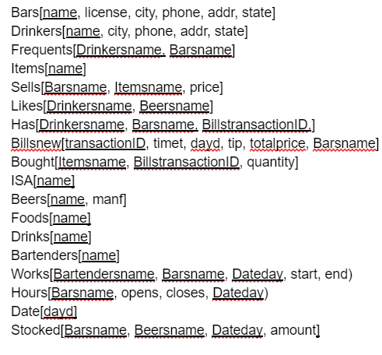
Relational Schema + ER Diagram
We first began developing the our project by planning out the ER Diagram and Relational Schema. As shown above, we can see our overall thought process on the design of the database.

Slide 3
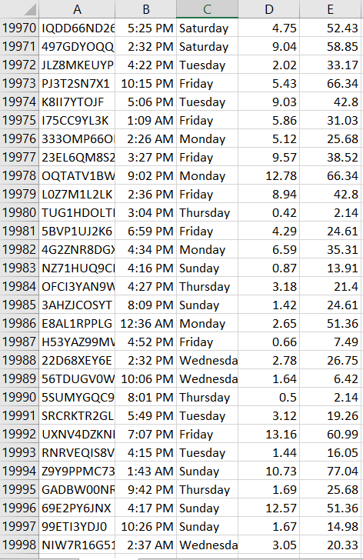
Generating Our Data
We first generated thousands of tuples following the patterns we were given. After converting our data to csv files, we then transported all this data into our database.

Slide 4
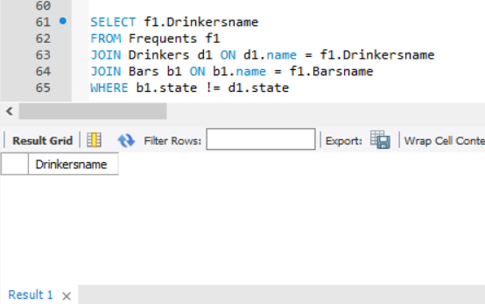
SQL Verification Queries
Next, we created queries to verify that our patterns held. This specific query is showing that no drinkers frequent bars that are located in different states from where they live.

Slide 5
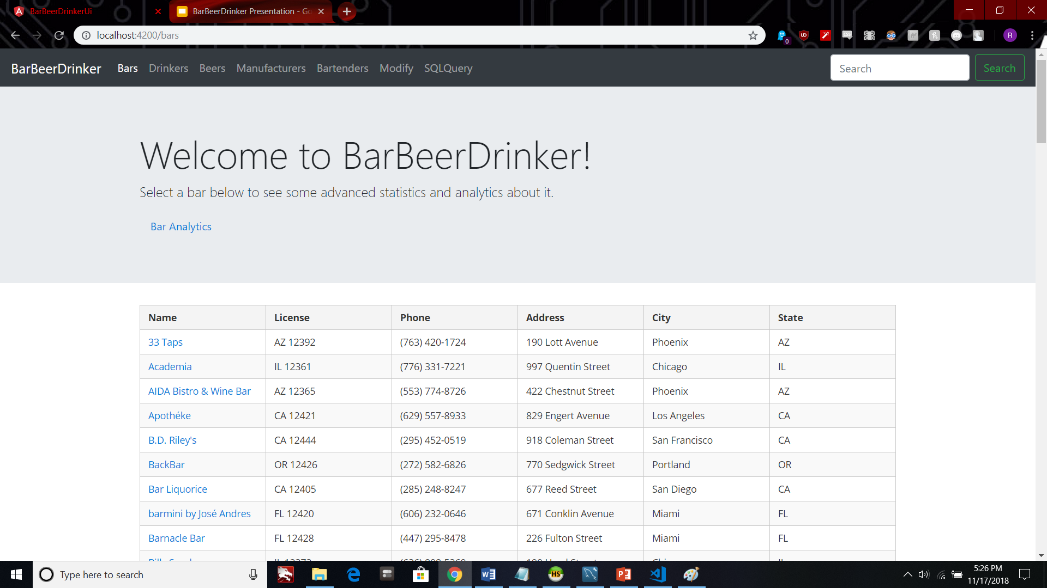
Finally utilizing technologies such as Python, Flask, Node.js, PrimeNG and AngularJS, we connected our SQL database to a full-stack web application.
For the home page , we created a table that lists all the bars and each bar’s attributes. Clicking a specific bar name gives you detailed information about that bar. We followed a similar pattern for the drinkers, beers, and manufacturers page, and set up a navbar with bootstrap to navigate through each category.

Slide 6
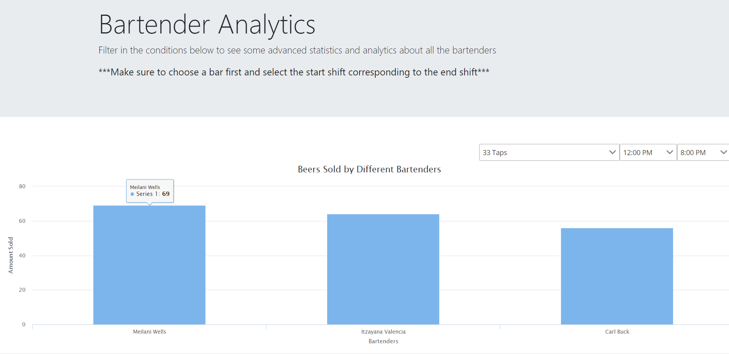
Analytics
For both bartenders and bars, we created an analytics pages to show users even more detailed information about all bartenders or bars instead of just a specific one.
On this page, you can select the bar and the shift timings to get the bartenders who sold the most beers during that shift.

Slide 7
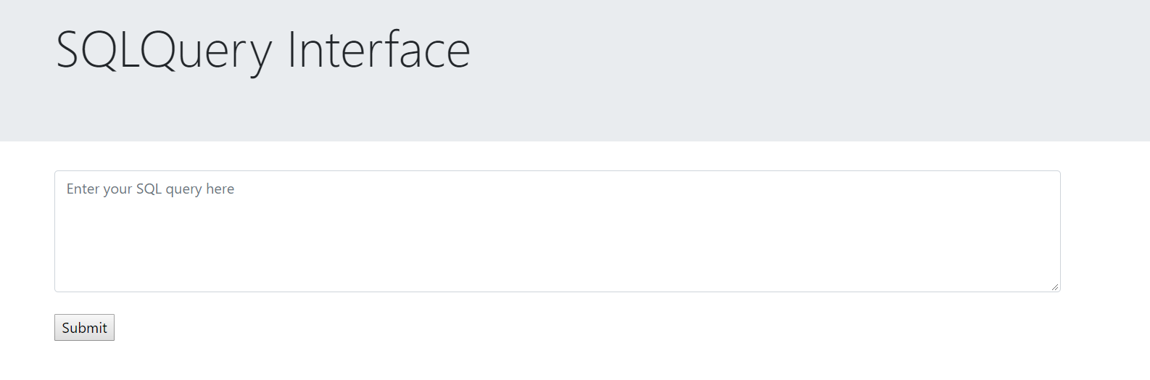
SQL Interface Page
Here, users can enter their own queries and generate results based on our database.

Slide 8
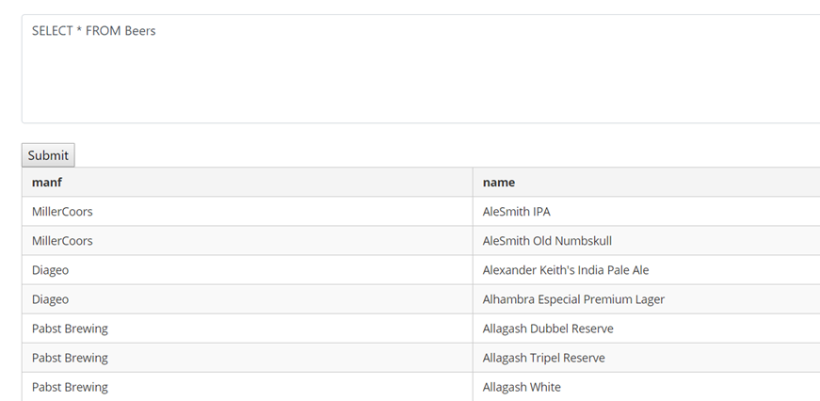

Slide 9
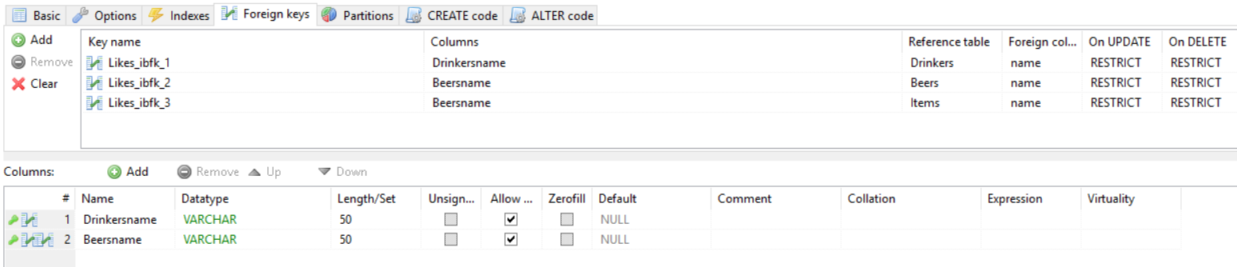
Foreign Keys
We created some foreign keys on tables to restrict the data coming into our database. Users can’t add a drinker to the likes table if that drinker does not exist in the drinker table. Likewise, the beer must also exist in the beers table.

Slide 10
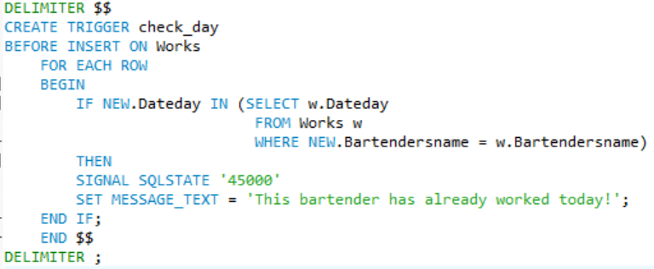
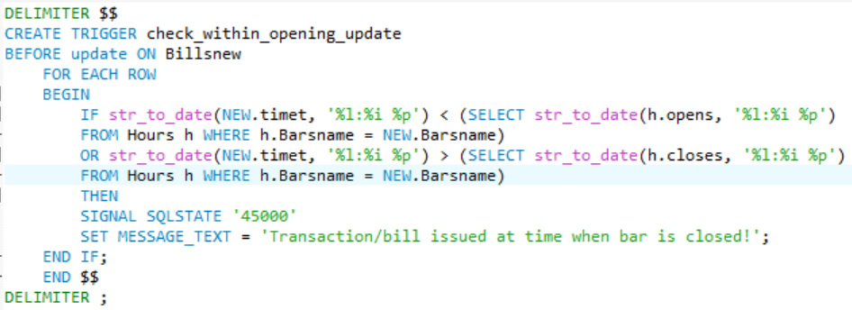
Assertions/Triggers
We then proceeded by creating triggers within our database to further enforce our 5 patterns as assertions. This means if an insert or update violates the assertion it *should not be allowed* and proper warning/explanation is displayed.
As demonstrated, we wrote a trigger to check whether an inserted bartender has already worked within that day.
This picture below shows that we wrote a trigger to check whether an update on a bill is still issued within opening hours of the bar.

Slide 11
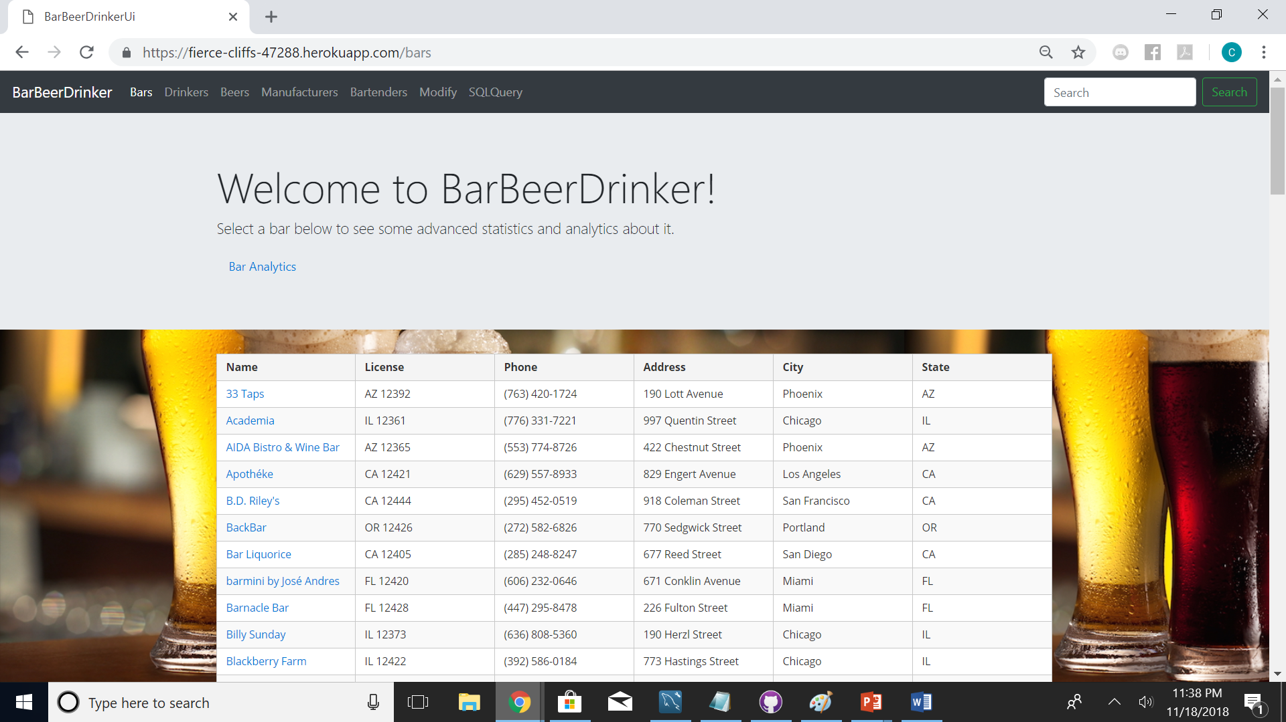
Hosting our Web Application Online
Finally, we took our finalized and polished BarBeerDrinker full-stack Web Application to the Internet. Hosting the code through Heroku, we were able to publish it through a URL.
https://fierce-cliffs-47288.herokuapp.com/static/index.html

Slide 12
Conclusion
Creating the BarBeerDrinker Web Application was a long exhausting journey. However, we have learned a lot through this adventure, and developed valuable knowledge and skills as students and future computer scientists. We share pride in our finished product, and will cherish this experience for as long as we can remember.

Slide 13
Thank You!

